Slide 2
Fusing Arts, Culture and Social Change through Sanskriti Sankalp’s First Annual Cultural Festival

Slide 4
SANSKRITI-ANNUAL CULT FEST
Sankalp organized its first ever Annual Cultural Meet since its inception on 11th Oct,2015
The festival was organized at the Community Centre at Imli Chauk centre, Durga Mandir
The meet was a huge success with intense participation from the selected children from all Jamshedpur based centres of Sankalp viz. NIT Centre, Mohan Nagar, Aashiyana Centre, Imli Chauk & Telco
The prominent events were Dramatics, Group Dance, Tribal Dance, Singing and Quiz
The overall champion of the meet was Mohan Nagar Centre with Telco and NIT Centre as runners up.

Slide 5
The making of Sanskriti
A walk to remember
2015

Slide 6
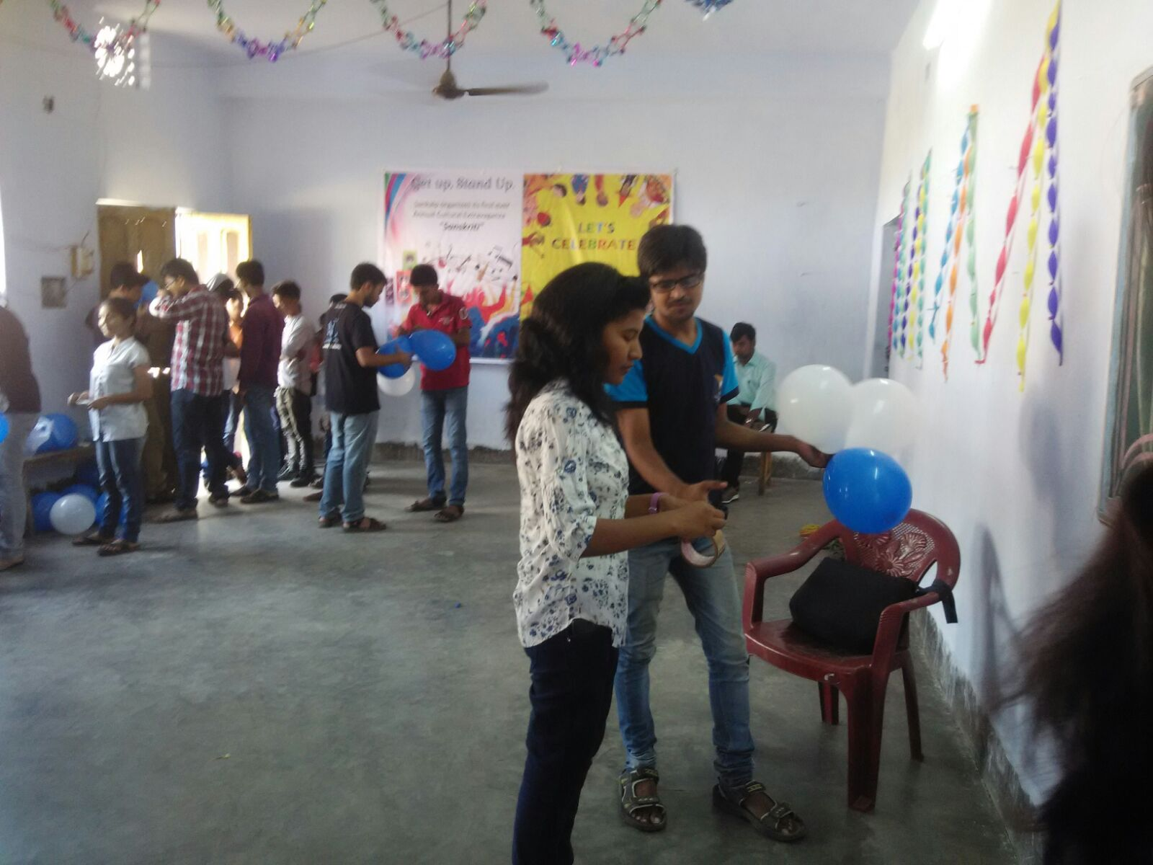
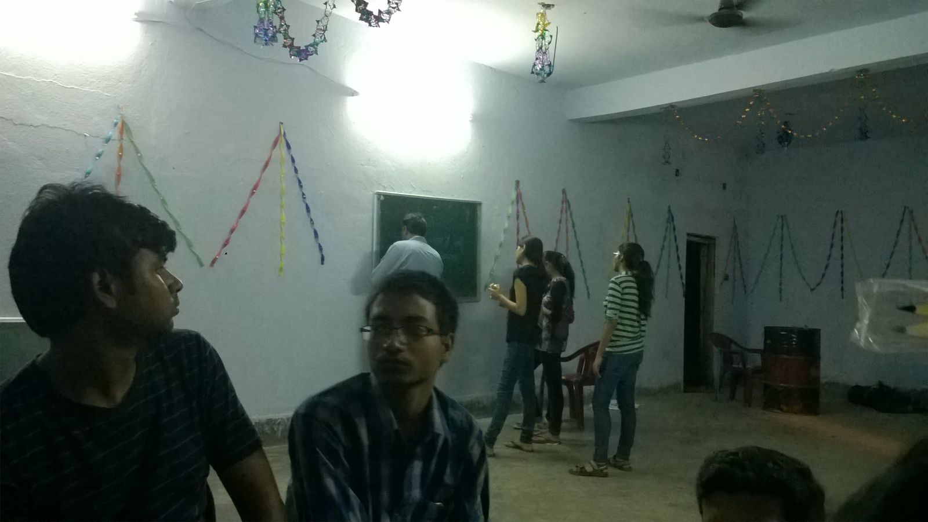
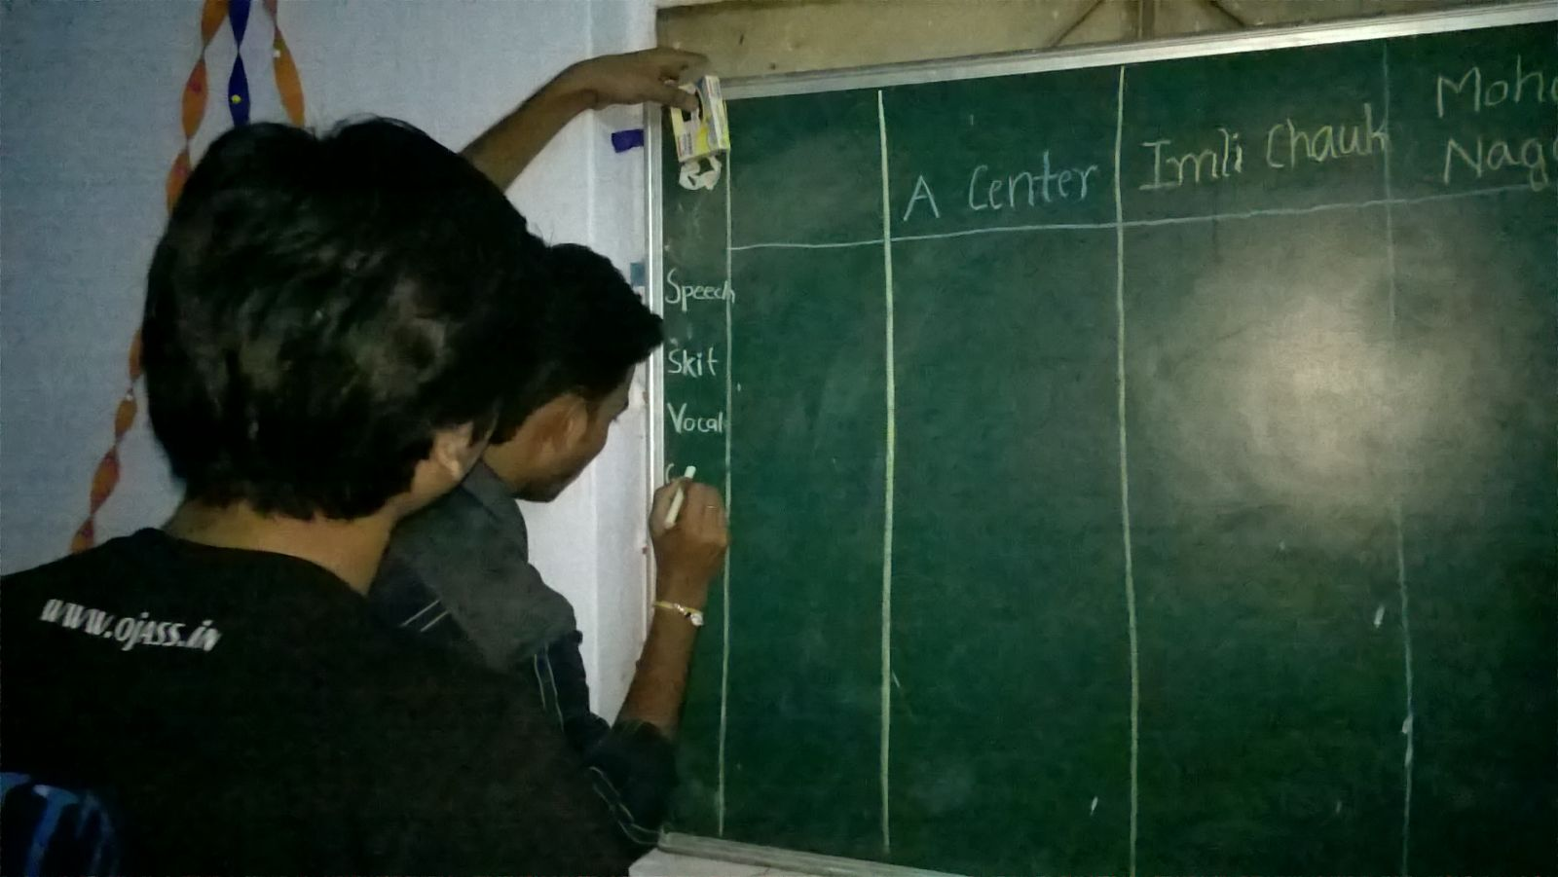

Slide 7
GET UP, STAND UP FOR SANSKRITI

Slide 8
And the show begins
For an extravaganza called
Sankriti
11th oct,2015

Slide 11
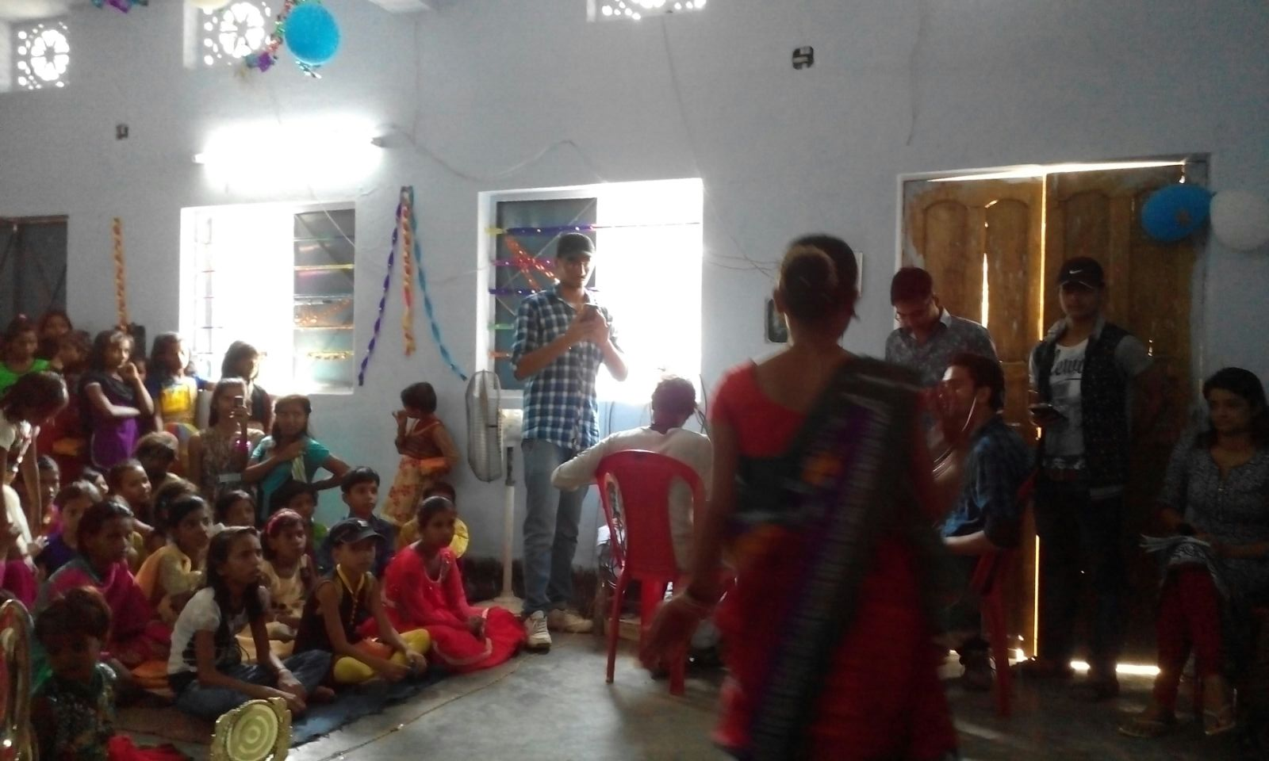
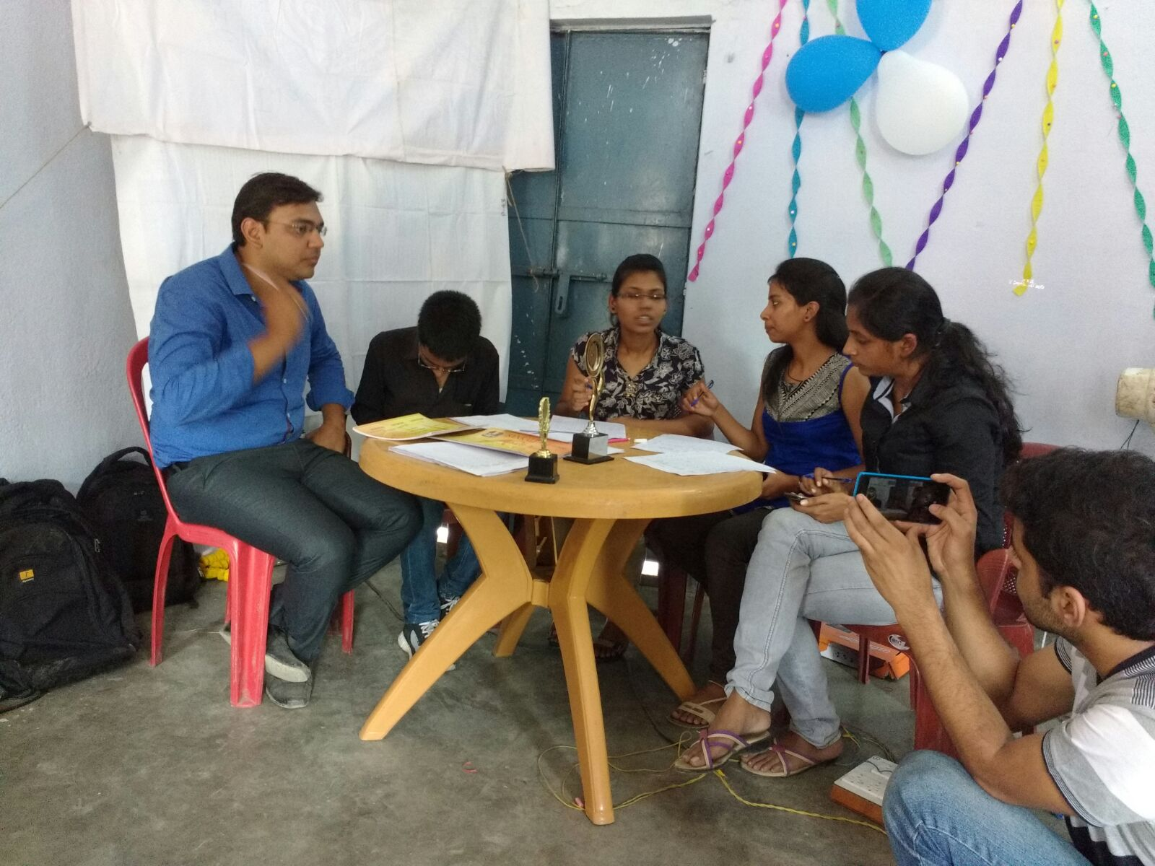

Slide 12
Performances
@
Sanskriti

Slide 13
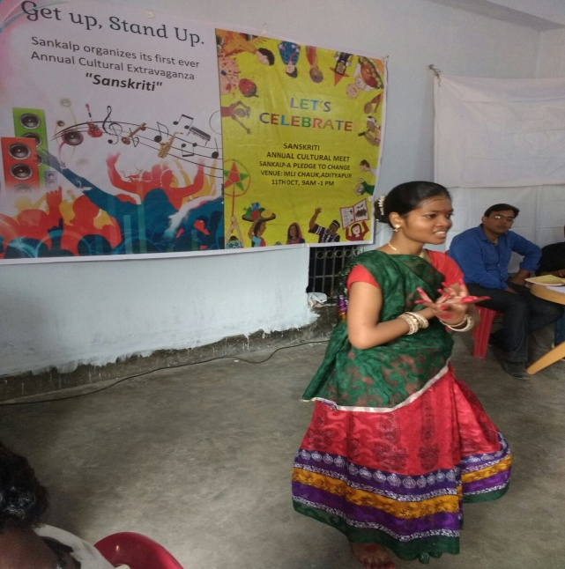
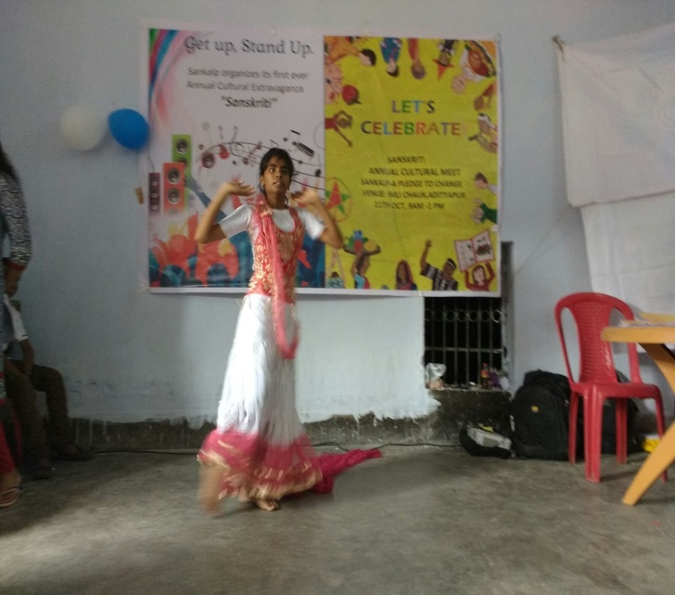
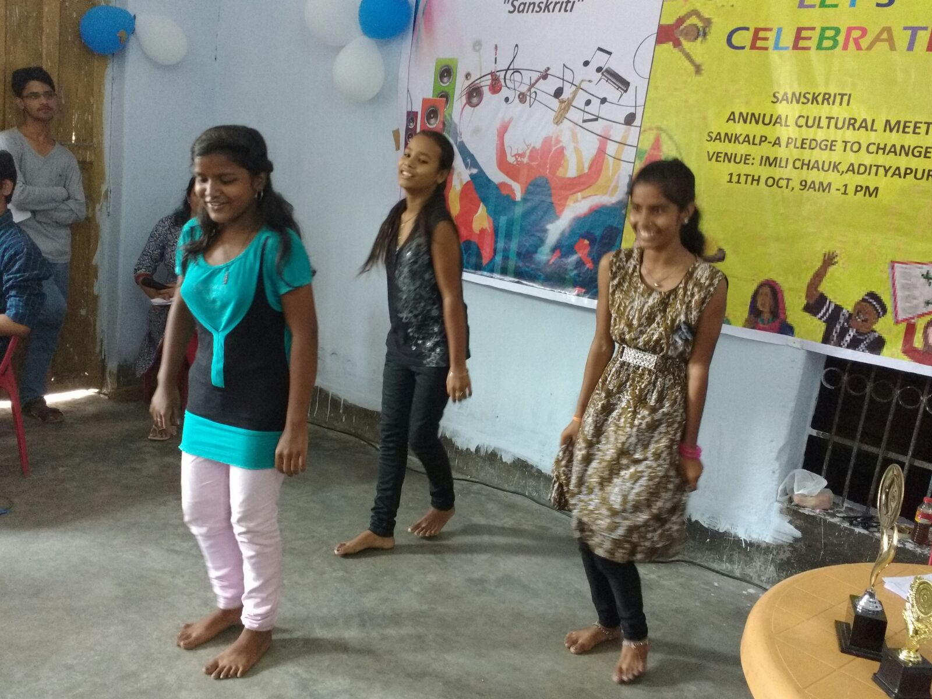
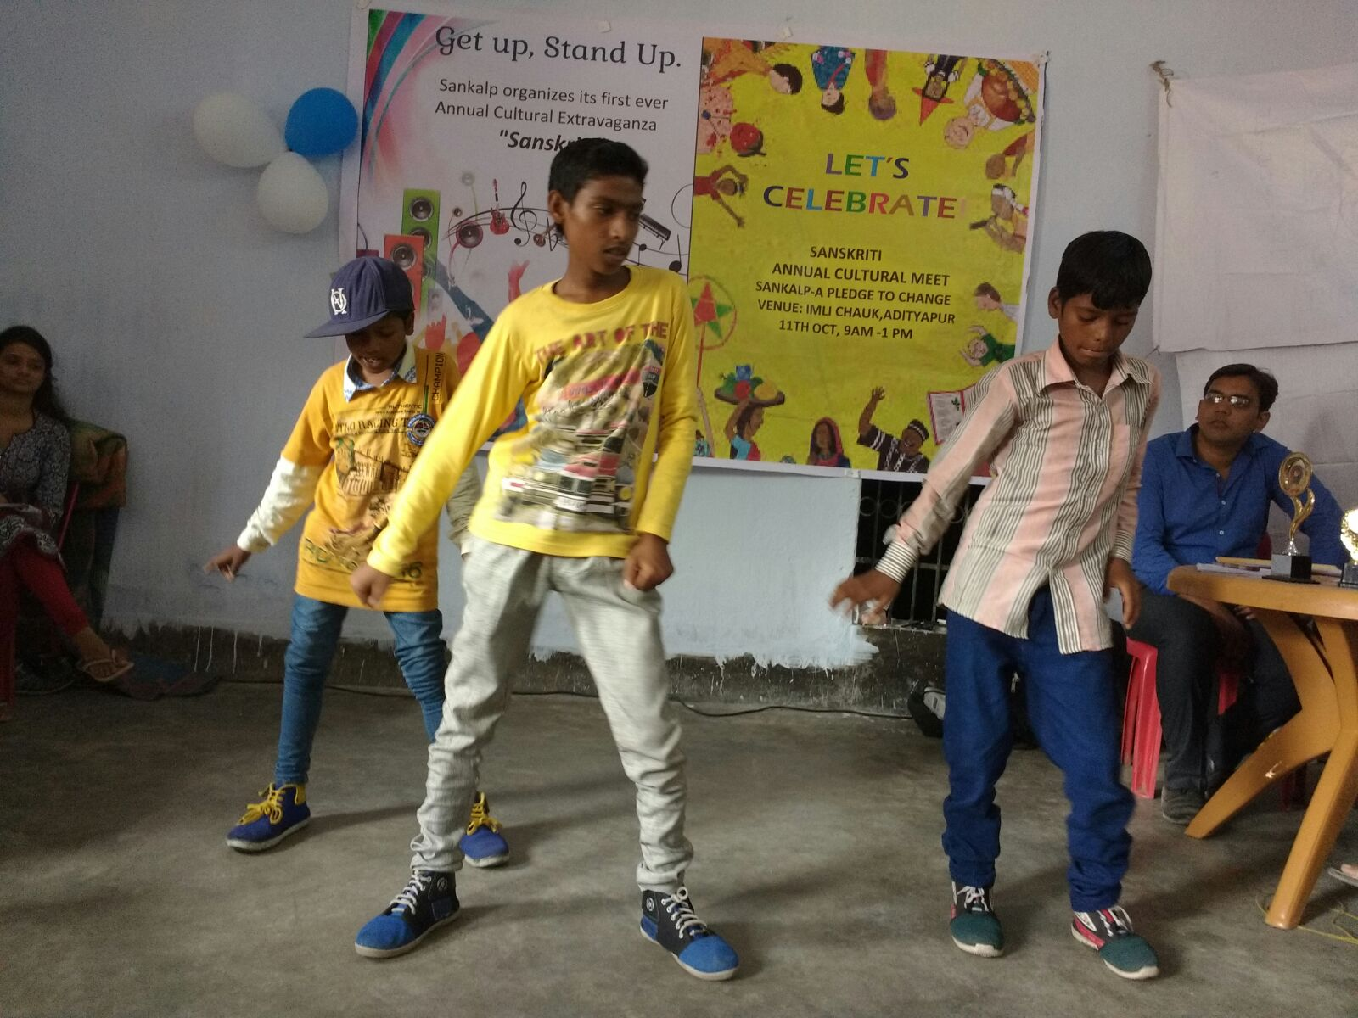

Slide 14
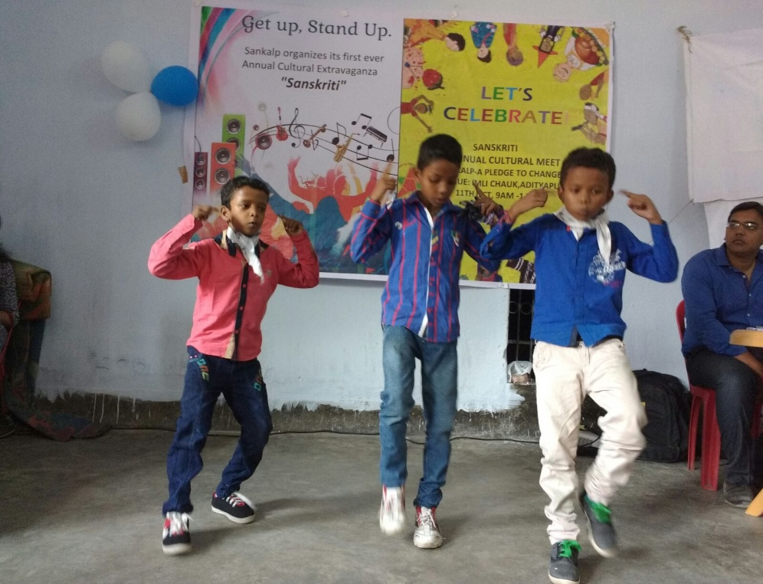
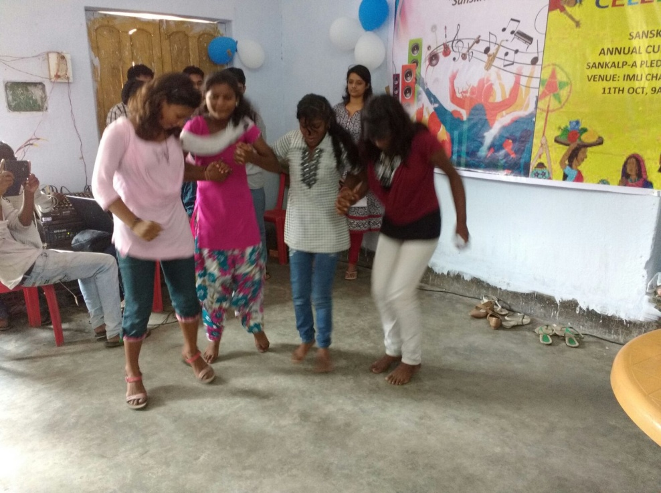
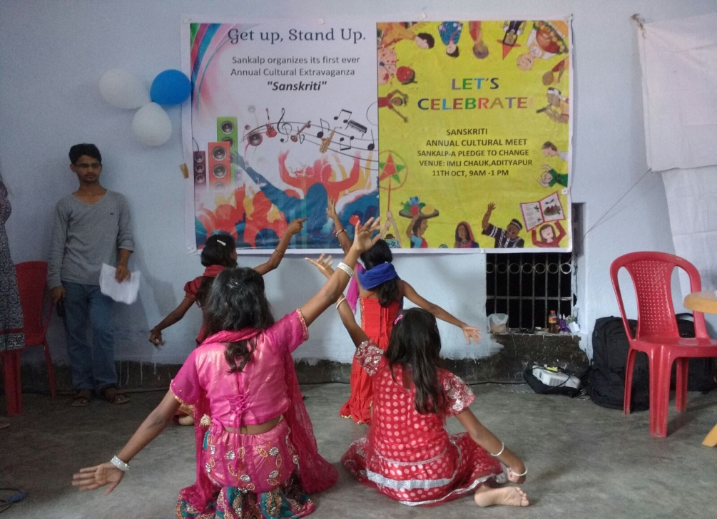

Slide 15
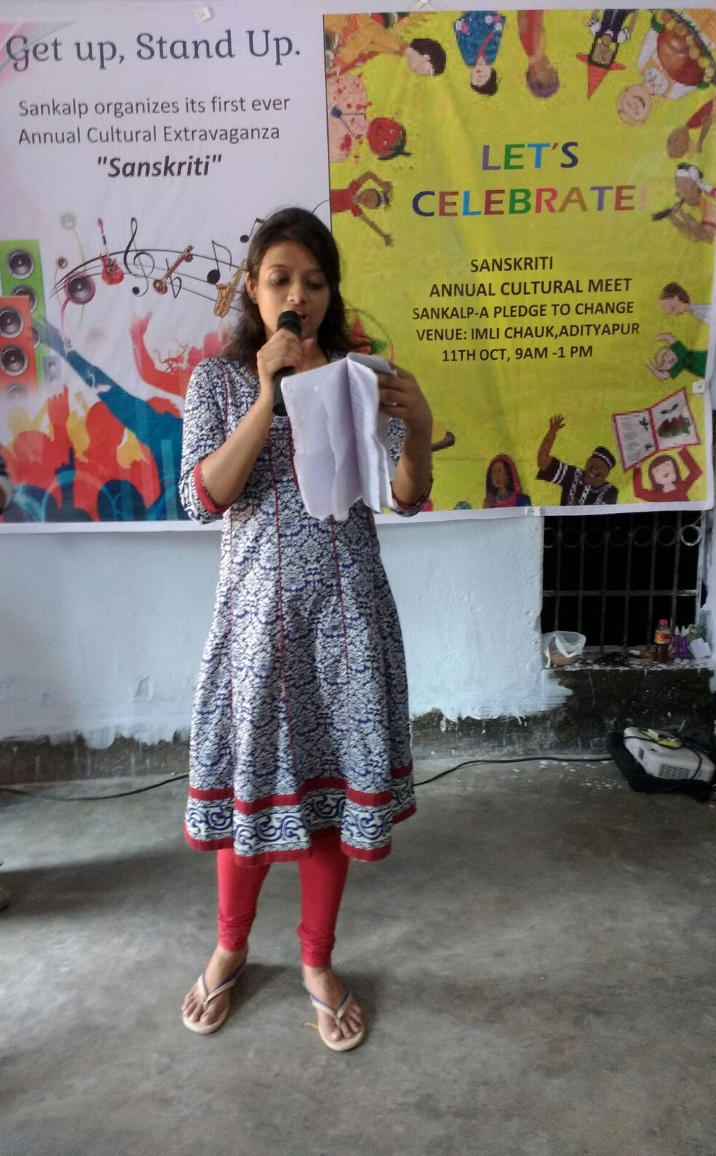
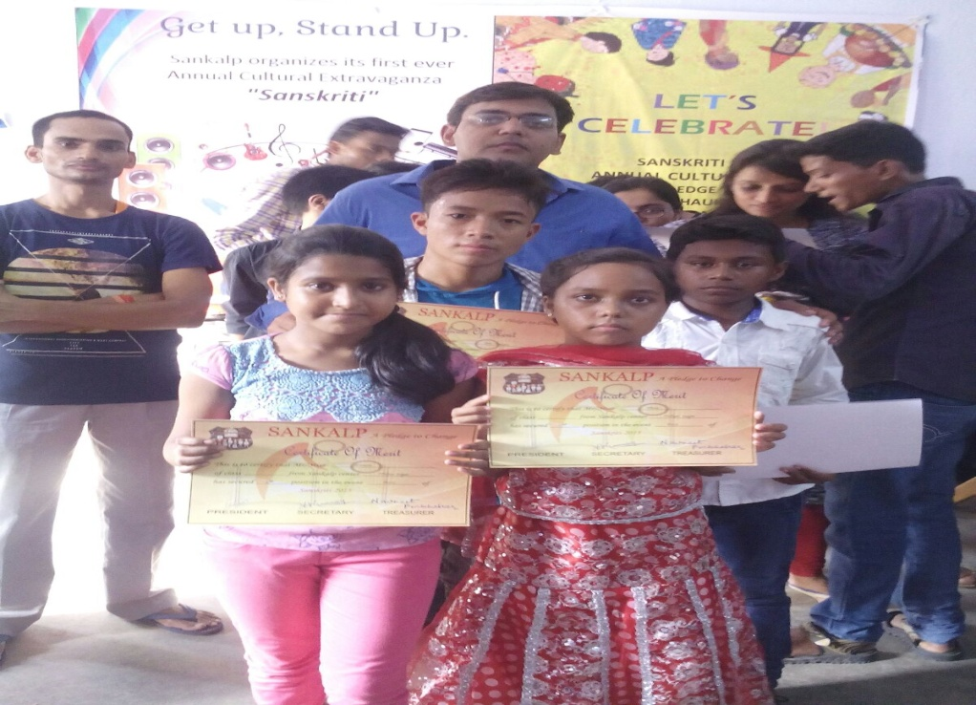
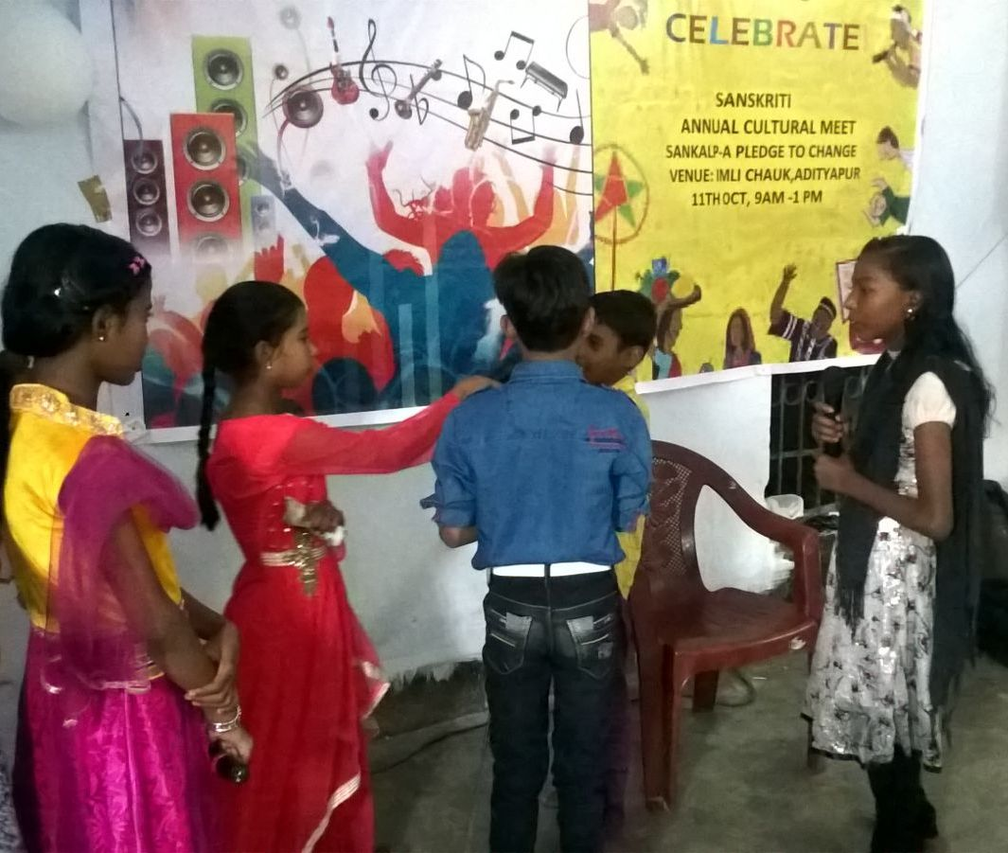

Slide 16
Sankalp Team
Welcomes Chief Guest for the Event
Branch Head,
State Bank Of India

Slide 18
Sankalp Team
The last lap of a victory called
A
Pledge To Change

Slide 21
LET’S BE A PART OF THE JOURNEY
You can donate at any our centres by just making a call to Sankalp-A Pledge to Change volunteers.
All our centres are Adityapur based and run 6 days a week
You may donate books from
Class 1-8- Course Text Books (Any Board)
Story Books
Unused stationery
Any other items like bag, toys, uniforms etc.
Relevant Contact Nos. Are
Subodh Kumar Das-9798756336
Mayank Aggarwal -9031975746
Suresh Pareek -7209632032
Vikas Dixit -9472706225

Slide 22
ACCOUNT DETAILS FOR SUPPORT
Sankalp Account Details
You can transfer funds online into our account:-
“SANKALP” A/C No.-31114719936
CIF No: 85757412911
IFSC Code: SBIN0001882
MICR Code: 831002004
Branch code: (1882)
Branch: SBI- RIT JAMSHEDPUR
You may also visit our website and pay through online link available over it.
www.sankalpnitjamshedpur.org

Slide 23
“You have not lived today until you have done something for someone who can never repay you.”
www.sankalpnitjamshedpur.org

