Slide 2
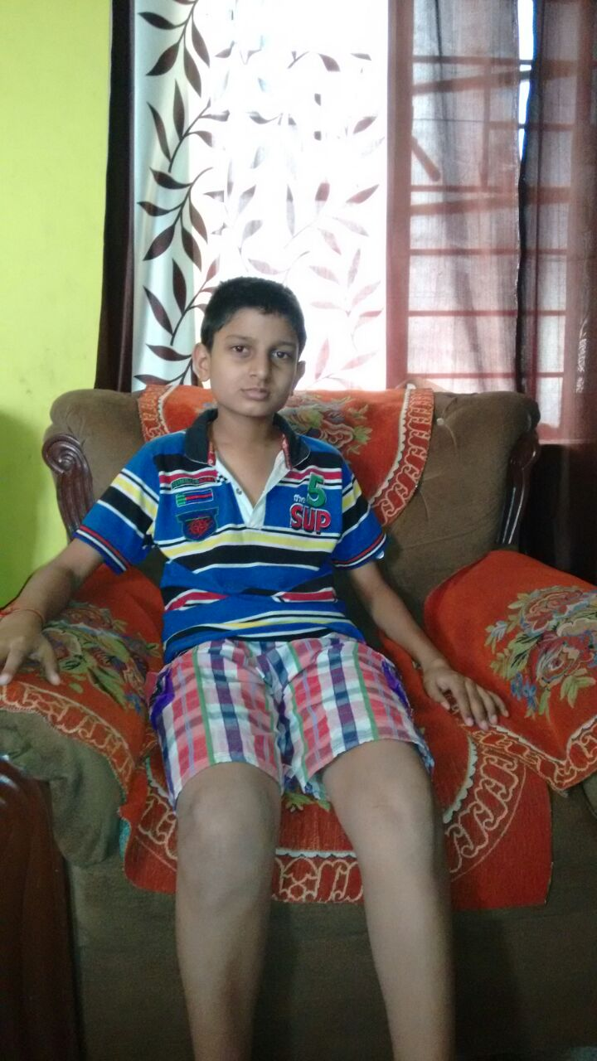
A MISSION ACCOMPLISHED!!!
Thanks to our well-wishers
SAMARTH PANDEY SARTHAK PANDEY

Slide 3
BRIEF CASE HISTORY
Sarthak and Samarth are sons of Ms. Renu Pandey, whose husband worked in a private company in Telco Area, Jamshedpur. On an unfortunate night of 11th Feb 2015 , her husband died of Cardio-Respiratory Failure.
The family facing extreme financial crunches and unable to finance the educational expenditure of their kids contacted Sankalp for monetary help.
Team Sankalp –A pledge to change met the family and has sponsored the re-admission fees of both there sons along with stationery and dress expenditure.
The total annual cost was Rs. 16,000 (@8000/child)
Sankalp donated Rs. 16000/-and got both the children admitted

Slide 4
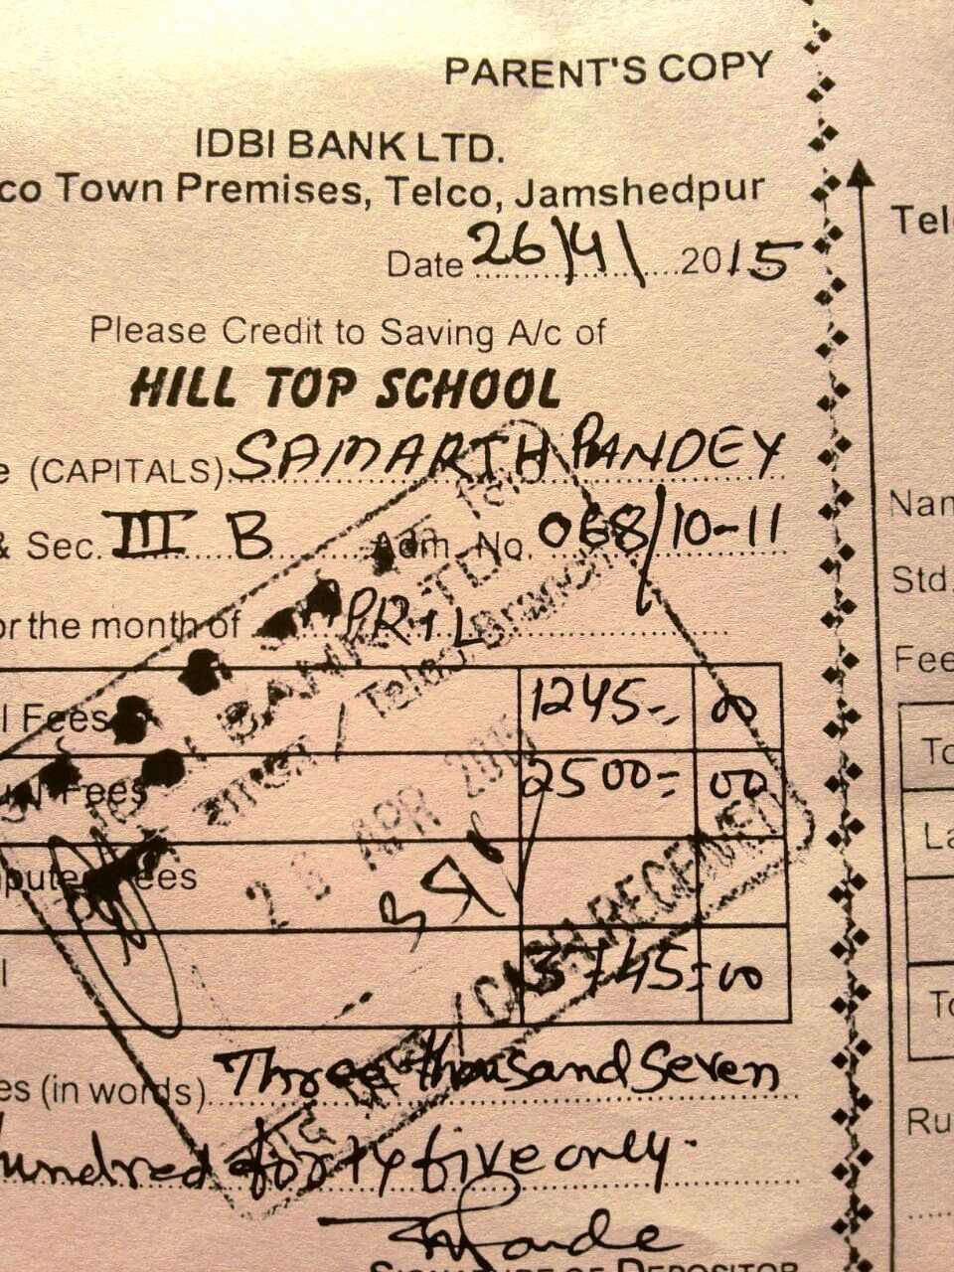
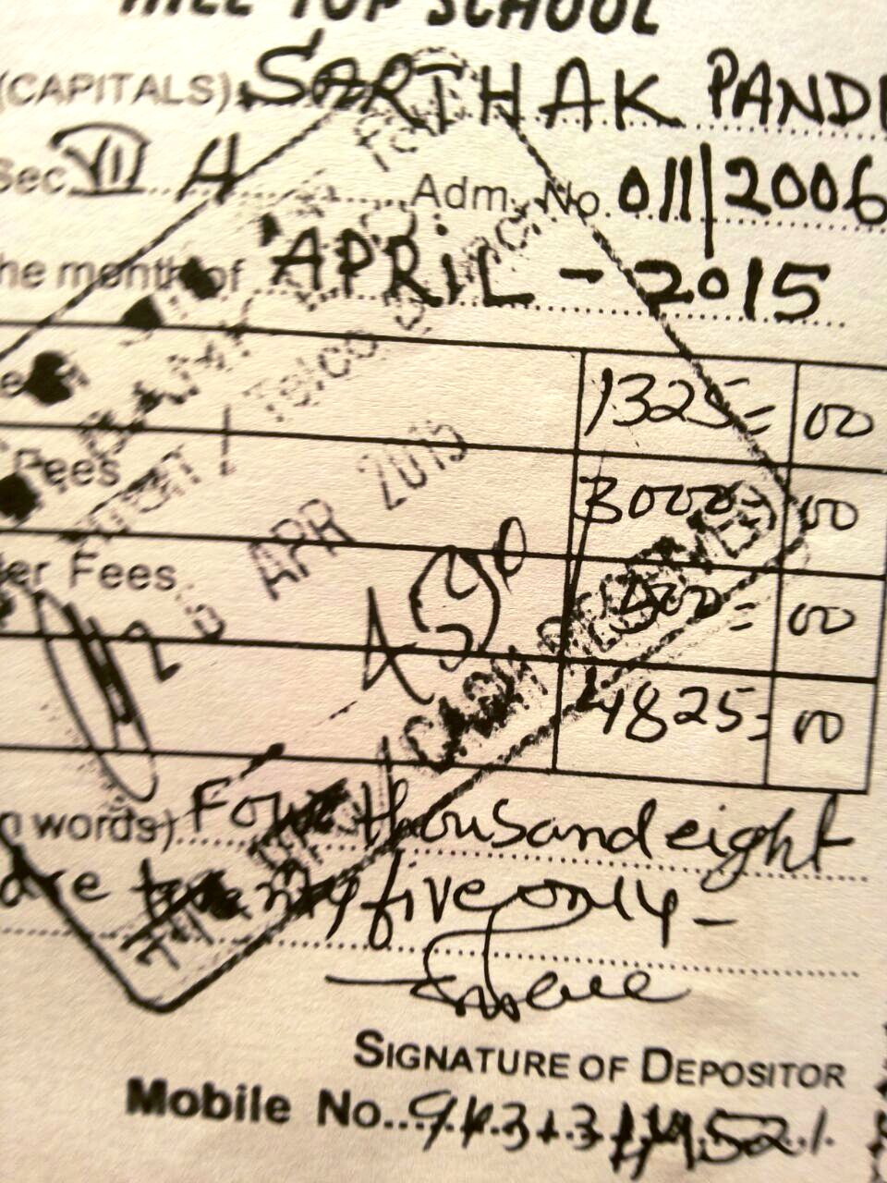
ADMISSION FEE RECEIPT AND HILL TOP SCHOOL DIARY

Slide 5
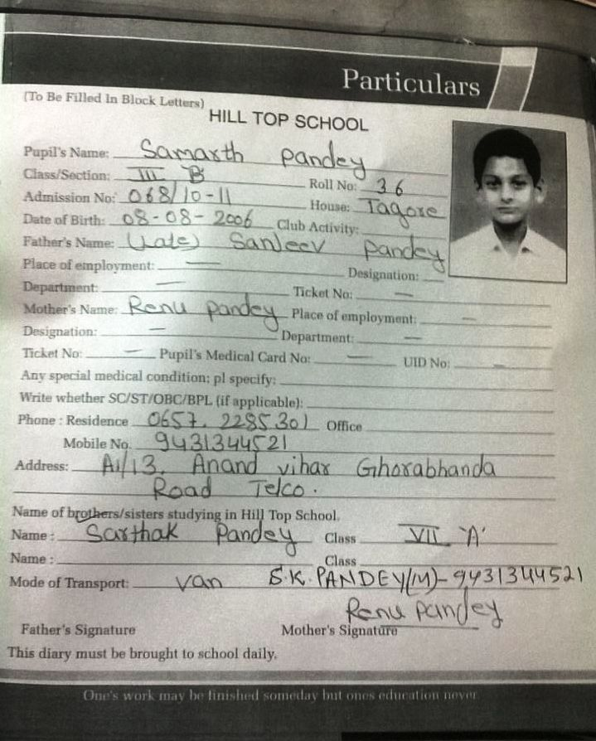
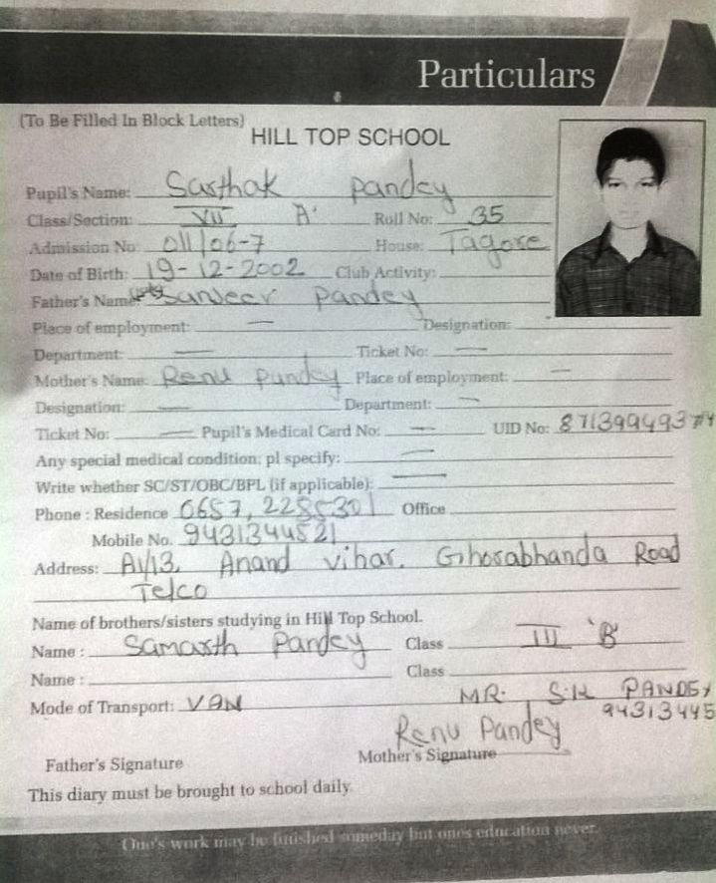
HILL TOP SCHOOL DIARY

Slide 6
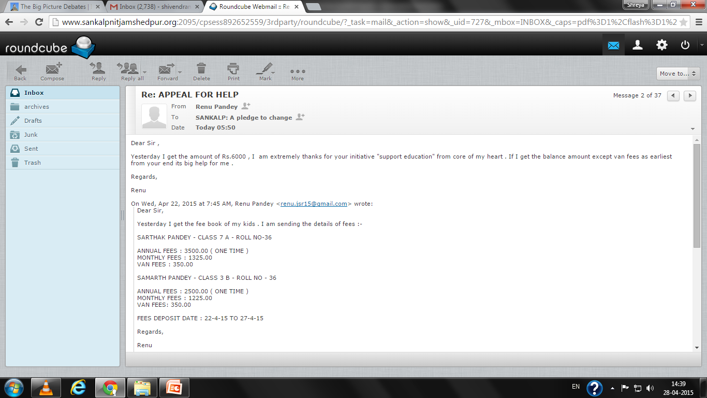
AND THOSE INVALUABLE WORDS....

Slide 7
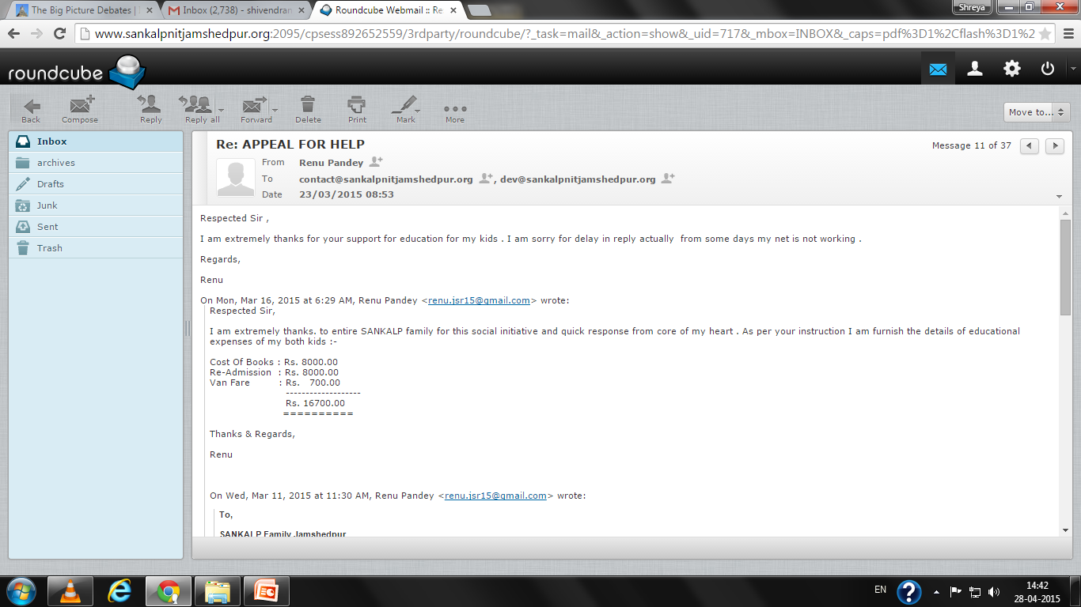
AND THOSE INVALUABLE WORDS....

Slide 8
“You have not lived today until you have done something for someone who can never repay you.”
Thank You
www.sankalpnitjamshedpur.org

