Slide 2
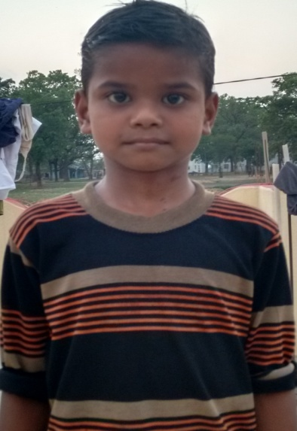
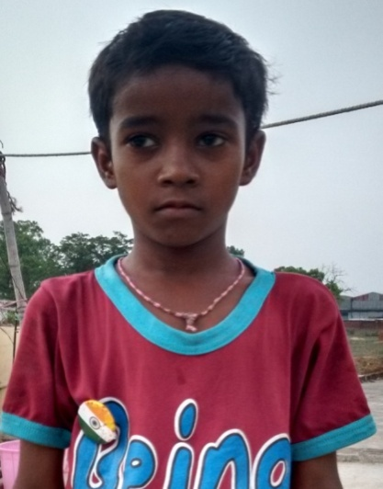
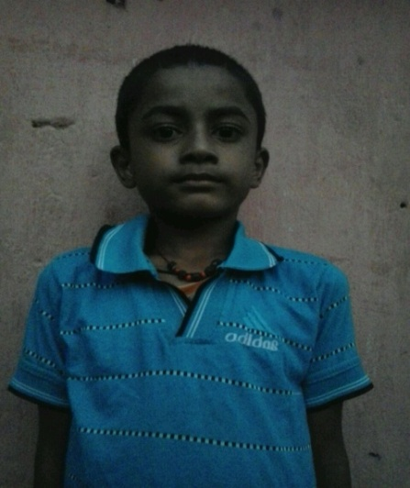
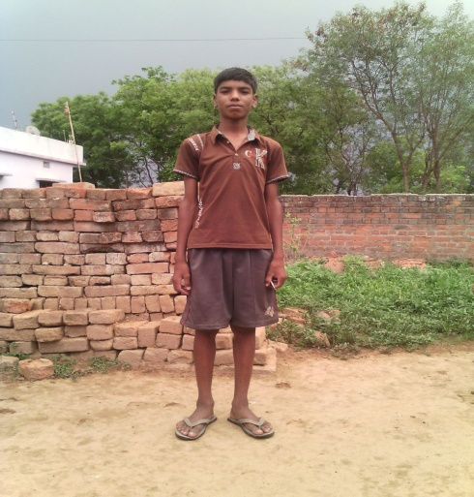
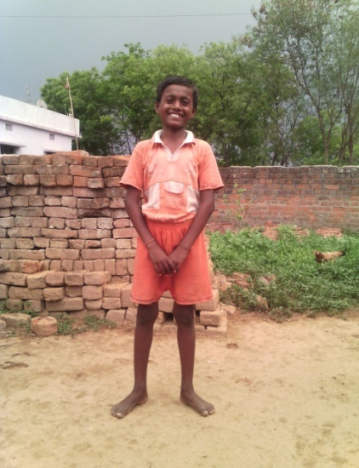
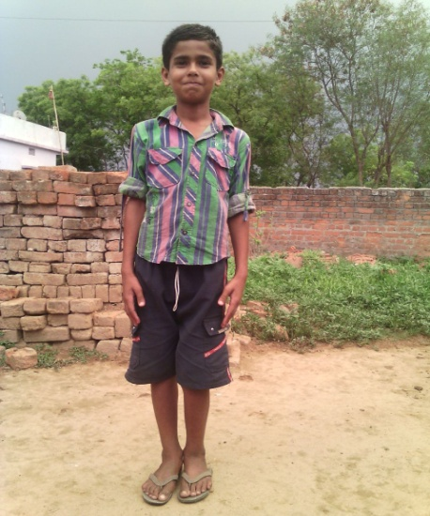
THE SMILING FACES !!!
ROHIT KUMAR SINGH TAPAN MAHATO GANESH MAHATO
MANISH ABHISHEK VISHAL

Slide 3
You were born with the ability to change someone’s life.
Don’t waste it.”

Slide 4
BRIeF CASE HISTORY
These underprivileged children belong to the tribal areas in the vicinity of NIT Jamshedpur
Parents of many of these are daily wage labourers, doodh-wallas, petty job –workers who cannot afford their kids’ education
These children were enrolled at our centres near Hostel-A and were taught by our volunteers on a daily basis
Sankalp-A Pledge to Change trained these kids for entrance exams of public schools across the city and 6 of them cleared the entrance at Gayatri Shiksha Niketan, Adityapur
Considering the economic status of their families, we took it upon ourselves to sponsor their complete admission fees, dress and stationery fees.
The kids now are attending regular classes at the school.

Slide 5
A hundred years from now. It will not matter what kind of car i drove, what kind of house i lived in, how much money i had in the bank..but the world may be a better place because i made a difference in the life of a child

Slide 6
A brief background of these kids

Slide 7
ROHIT KUMAR SINGH
PERSONAL DETAILS:
Class: 1
Gender: Male
School: Gayatri Shiksha Niketan,
Adityapur, CBSE
Medium of instruction: English
DETAILS ABOUT FAMILY:
Father’s name: Arun Singh
Mother’s name: Late Aneema Devi
No of members in family: Two- Rohit and his father
Profession of father: Machine operator in Adityapur Industries
FINANCIAL OVERVIEW:
Monthly net income of household: Rs. 8000/-
Total annual expenditure on education: Rs. 17450/-
Breakup of expenses
Tuition fees: Rs 550/- (per month) = Rs. 6600/- (per year)
Admission fees: Rs. 3150/- (per year)
Stationery: Rs. 3500/- (per year)
Bus fare: Rs. 350/-(per month) = Rs. 4200/- (per year)
Average monthly expenditure on education: Rs. 1450/-

Slide 8
TAPAN MAHTO
PERSONAL DETAILS:
Class: UKG
Gender: Male
School: Gayatri Shiksha Niketan,
Adityapur,CBSE
Medium of instruction: English
DETAILS ABOUT FAMILY:
Father’s name: Harmohan Mahto
Mother’s name: Vinota Mahto
No of members in family: Five- two brothers, 1 sister, mother and father
Profession of father: Machine operator in Adityapur Industries
Profession of mother: Housewife
FINANCIAL OVERVIEW:
Monthly net income of household: Rs. 5000/-
Total annual expenditure on education: Rs. 16600/-
Breakup of expenses
Tuition fees: Rs 500/- (per month) = Rs. 6000/- (per year)
Admission fees: Rs. 2900/- (per year)
Stationery: Rs. 3500/- (per year)
Auto fare: Rs. 350/-(per month) = Rs. 4200/- (per year)
Average monthly expenditure on education: Rs. 1380/-

Slide 9
GANESH MAHATO
PERSONAL DETAILS:
Class: I
Gender: Male
School: Gayatri Shiksha Niketan,
Adityapur
Board of School: CBSE
Medium of instruction: English
DETAILS ABOUT FAMILY:
Father’s name: Bhilesh Mahato
Mother’s name: Anju Devi
No of members in family: Five- two brothers, 1 sister, mother and father
Profession of father: Auto driver
Profession of mother: Housewife
FINANCIAL OVERVIEW:
Monthly net income of household: Rs. 3000/-
Total annual expenditure on education: Rs. 17450/-
Breakup of expenses
Tuition fees: Rs 550/- (per month) = Rs. 6600/- (per year)
Admission fees: Rs. 3150/- (per year)
Stationery: Rs. 3500/- (per year)
Bus fare: Rs. 350/-(per month) = Rs. 4200/- (per year)
Average monthly expenditure on education: Rs. 1450/-

Slide 10
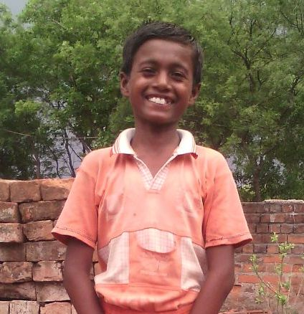
ABHISHEK KUMAR
PERSONAL DETAILS:
Class: III
Gender: Male
School: Gayatri Shiksha Niketan,
Adityapur
Board of School: CBSE
Medium of instruction: English
DETAILS ABOUT FAMILY:
Father’s name: Ramashish Singh
Mother’s name: Savita Devi
No of members in family: Five- two brothers, one sister, mother and father
Profession of father: Milkman
Profession of mother: Housewife
FINANCIAL OVERVIEW:
Monthly net income of household: Rs. 6000/-
Total annual expenditure on education: Rs. 10,800/-
Breakup of expenses
Admission fees: Rs. 3500/- (per year)
Stationery: Rs. 3900/- (per year)
Dress: Rs. 1000/-
Bus fare: Rs. 200/-(per month) = Rs. 2400/- (per year)

Slide 11
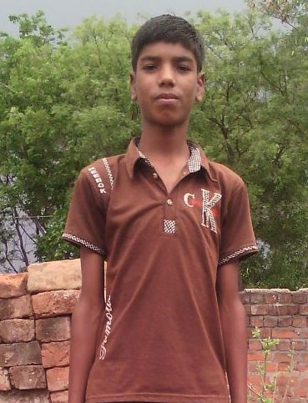
MANISH KUMAR
PERSONAL DETAILS:
Class: V
Gender: Male
School: Gayatri Shiksha Niketan,
Adityapur
Board of School: CBSE
Medium of instruction: English
DETAILS ABOUT FAMILY:
Father’s name: Rajnath Singh
Mother’s name: Mantokha Devi
No of members in family: Four- two brothers, mother and father
Profession of father: Machine operator in a local company in Adityapur Industrial Area
Profession of mother: Housewife
FINANCIAL OVERVIEW:
Monthly net income of household: Rs. 6000/-
Total annual expenditure on education: Rs. 11,150/-
Breakup of expenses
Admission fees: Rs. 3750/- (per year)
Stationery: Rs. 4000/- (per year)
Dress: Rs.1000/-
Bus fare: Rs. 200/-(per month) = Rs. 2400/- (per year)

Slide 12
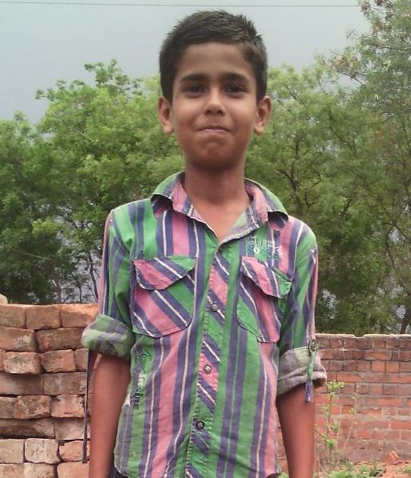
VISHAL KUMAR
PERSONAL DETAILS:
Class: III
Gender: Male
School: Gayatri Shiksha Niketan,
Adityapur
Board of School: CBSE
Medium of instruction: English
DETAILS ABOUT FAMILY:
Father’s name: Baban Singh
Mother’s name: Urmila Devi
No of members in family: Three- Vishal, mother and father
Profession of father: Businessman
Profession of mother: Housewife
FINANCIAL OVERVIEW:
Monthly net income of household: Rs. 6000/-
Total annual expenditure on education: Rs. 10,800/-
Breakup of expenses
Admission fees: Rs. 3500/- (per year)
Stationery: Rs. 3900/- (per year)
Dress: Rs.1000
Bus fare: Rs. 200/-(per month) = Rs. 2400/- (per year)

Slide 13
APPEAL FOR SUPPORT
Sankalp-A Pledge to Change has funded the complete education fee, admission fee and other expenditure of these children.
They are now attending regular classes at Gayatri Shiksha Niketan
We request alumnus and well-wishers of these kids and Sankalp to contribute financially so that together we can build a bright future for these kids.
Cost Break-Up is as follows
Annual Re-Admission Fees: Rs. 4000/child
Annual Dress Fees: Rs. 1000/child
Annual Stationery Fees: Rs. 3900/child
Transportation Fees: Rs. 2400/child
Annual Tuition Fees: Rs. 6600/child
Gross Expenditure per annum: Rs.17900/child

Slide 14
DETAILS FOR SUPPORT
Sankalp Account Details
You can transfer funds online into our account:-
“SANKALP” A/C No.-31114719936
CIF No: 85757412911
IFSC Code: SBIN0001882
MICR Code: 831002004
Branch code: (1882)
Branch: SBI- RIT JAMSHEDPUR
You may also visit our website and pay through online link available over it.
www.sankalpnitjamshedpur.org

Slide 15
“You have not lived today until you have done something for someone who can never repay you.”
Thank You
www.sankalpnitjamshedpur.org

