Slide 2
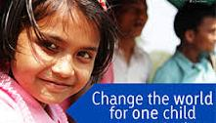
SPONSOR A CHILD BECOME A PART OF HIS FUTURE

Slide 3
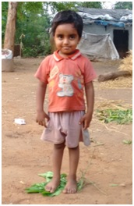
SITTU KUMAR
Class: Nursery
School: Gayatri Shiksha Niketan
Board of Education: CBSE
Monthly Income of Household: ₹3000
Area of Residence: Nepali Basti, Adityapur
No. of members in family: 4
Total Annual Expenditure on Education: ₹12450

Slide 4
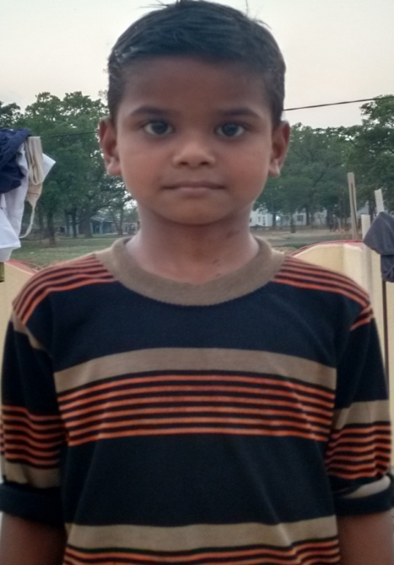
ROHIT KUMAR
Class: I
School: Gayatri Shiksha Niketan
Board of Education: CBSE
Monthly Income of Household: ₹8000
Area of Residence: Nepali Basti, Adityapur
No. of members in family: 2
Total Annual Expenditure on Education: ₹17450

Slide 5
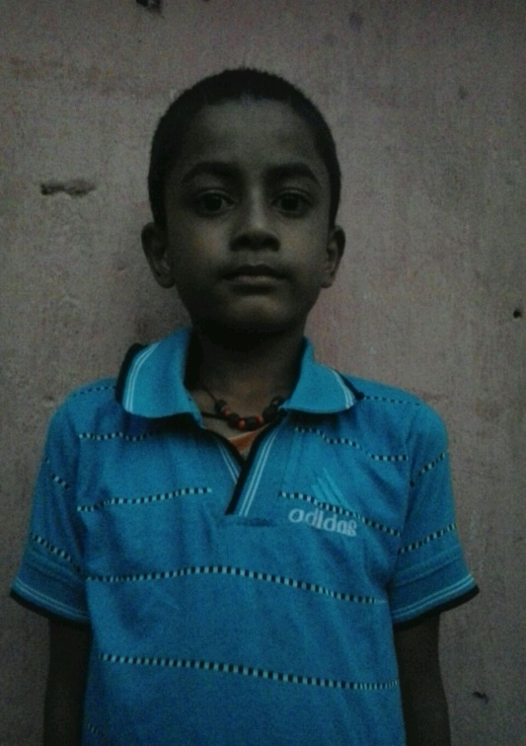
GANESH MAHATO
Class: I
School: Gayatri Shiksha Niketan
Board of Education: CBSE
Monthly Income of Household: ₹3000
Area of Residence: Nepali Basti, Adityapur
No. of members in family: 5
Total Annual Expenditure on Education: ₹17450

Slide 6
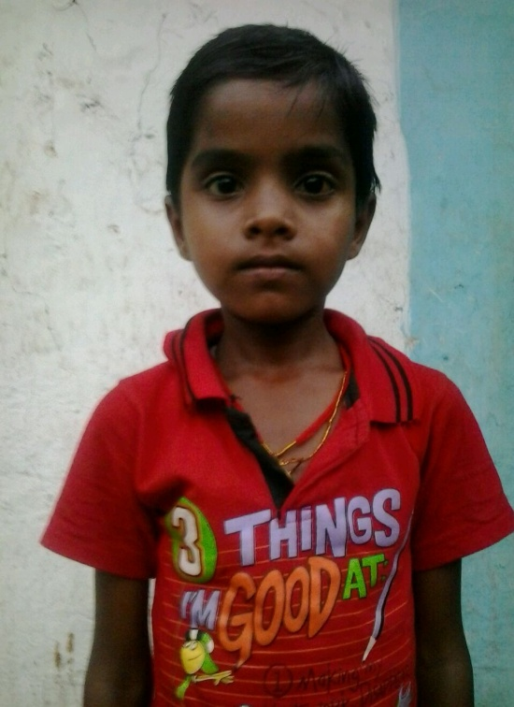
SONU KUMAR
Class: II
School: Gayatri Shiksha Niketan
Board of Education: CBSE
Monthly Income of Household: ₹3000
Area of Residence: Nepali Basti, Adityapur
No. of members in family: 3
Total Annual Expenditure on Education: ₹16500

Slide 7
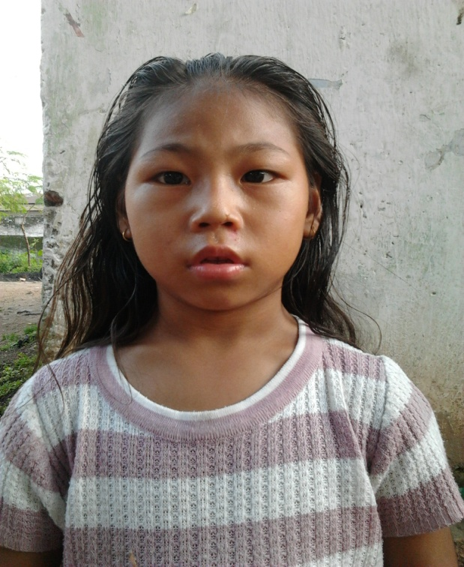
KUSUM KUMARI
Class: III
School: Gayatri Shiksha Niketan
Board of Education: CBSE
Monthly Income of Household: ₹2900
Area of Residence: Nepali Basti, Adityapur
No. of members in family: 4
Total Annual Expenditure on Education: ₹15850

Slide 8
SUBHASH THAPA
PHOTO:NA
Class: IV
School: Gayatri Shiksha Niketan
Board of Education: CBSE
Monthly Income of Household: ₹3300
No. of members in family: 4
Total Annual Expenditure on Education: ₹17050

Slide 9
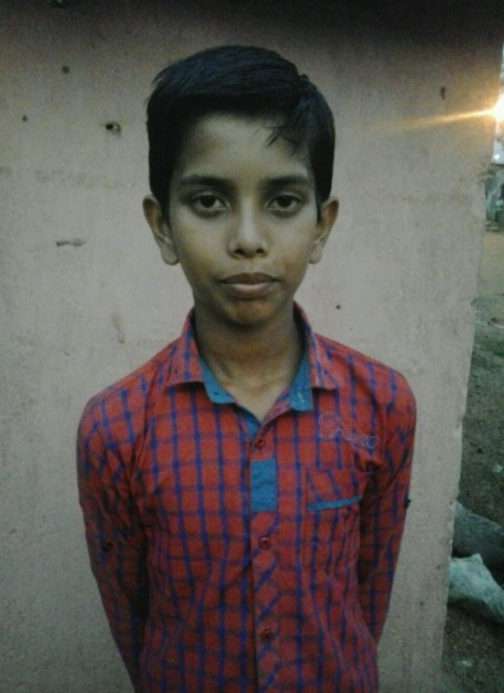
KARAN KUMAR SHARMA
Class: V
School: Gayatri Shiksha Niketan
Board of Education: CBSE
Monthly Income of Household: ₹3500
Area of Residence: Nepali Basti, Adityapur
No. of members in family: 5
Total Annual Expenditure on Education: ₹13900

Slide 10
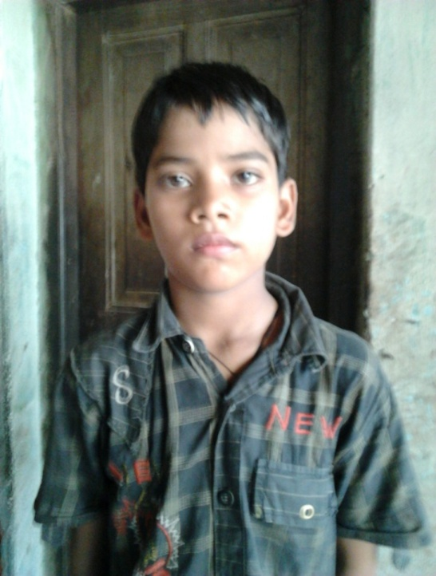
AMAN KUMAR SHARMA
Class: V
School: Gayatri Shiksha Niketan
Board of Education: CBSE
Monthly Income of Household: ₹3500
Area of Residence: Nepali Basti, Adityapur
No. of members in family: 5
Total Annual Expenditure on Education: ₹13900

Slide 11
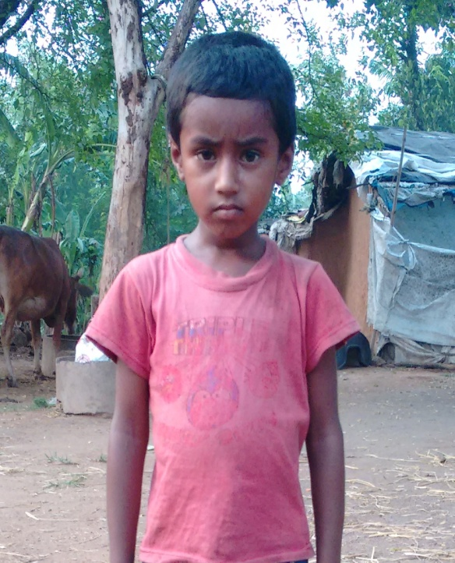
BITTU KUMAR
Class: UKG
School: Victoria Public School
Board of Education: CBSE
Monthly Income of Household: ₹3000
Area of Residence: Nepali Basti, Adityapur
No. of members in family: 4
Total Annual Expenditure on Education: ₹10620

Slide 12
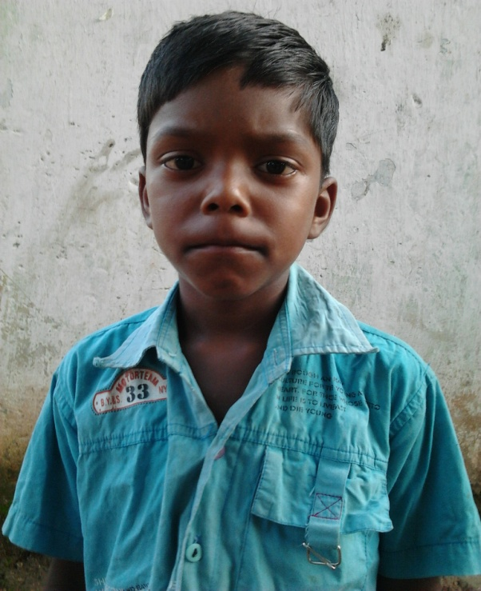
RIJU MAL
Class: III
School: Victoria Public School
Board of Education: CBSE
Monthly Income of Household: ₹2000
Area of Residence: Nepali Basti, Adityapur
No. of members in family: 4
Total Annual Expenditure on Education: ₹10650

Slide 13
LIGHTEN SOMEONE’S WORLD
Be a part of our Mission Education Campaign
These children belong to the underprivileged section of society and cannot afford their educational fee and other expenditure
They are currently sponsored thru Sankalp’s Central Fund
You can share Sankalp’s fund allocation to these children by becoming their individual sponsors
This will help Sankalp save its funds and focus on more such needy children to be identified by undertaking ground level surveys in nearby tribal areas

Slide 14
“If we did all the things we were capable of, we would astound ourselves”- Thomas A. Edison

Slide 15
STUDENTS CURRENTLY SPONSORED BY ALUMNIS/INDEPENDENT SOCIAL ENTHUSIASTS THRU SANKALP

Slide 16
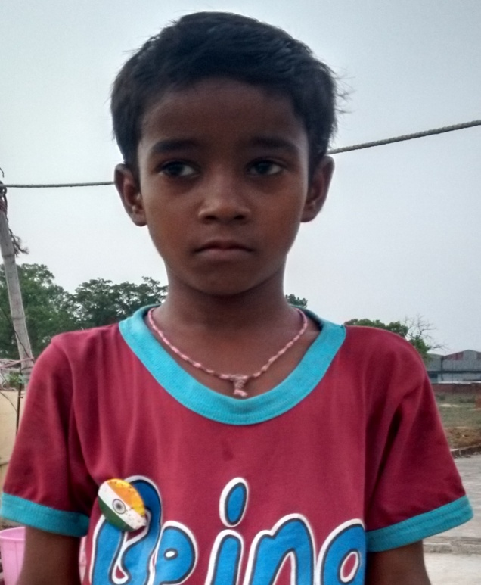
TAPAN KUMAR
Class: UKG
School: Gayatri Shiksha Niketan
Board of Education: CBSE
Monthly Income of Household: ₹5000
No. of members in family: 5
Total Annual Expenditure on Education: ₹16600
Sponsored by: SM KASTUAR TRUST

Slide 17
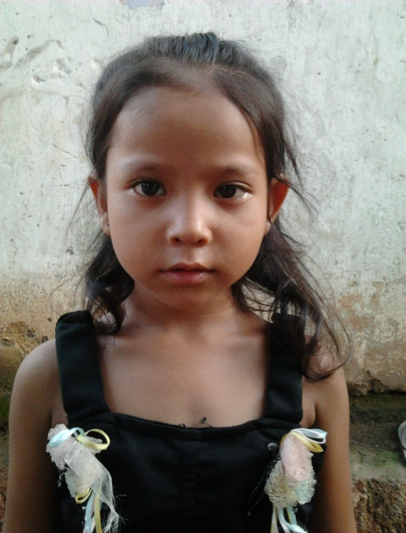
NANDINI KUMARI
Class: I
School: Gayatri Shiksha Niketan
Board of Education: CBSE
Monthly Income of Household: ₹1000
No. of members in family: 4
Total Annual Expenditure on Education: ₹16200
Sponsored by: MS. SNEHA PRIYADARSHI

Slide 18
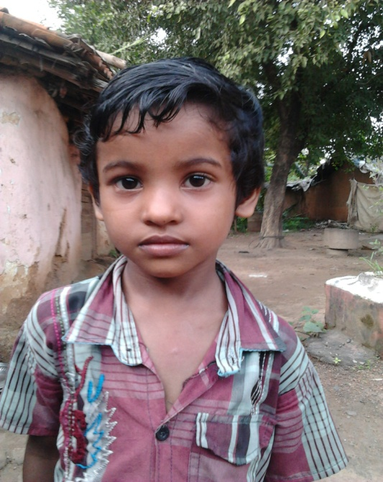
SABITA PATRA
Class: II
School: Gayatri Shiksha Niketan
Board of Education: CBSE
Monthly Income of Household: ₹3000
No. of members in family: 4
Total Annual Expenditure on Education: ₹15600
Sponsored by: MR. PRABHAKAR NAHAK

Slide 19
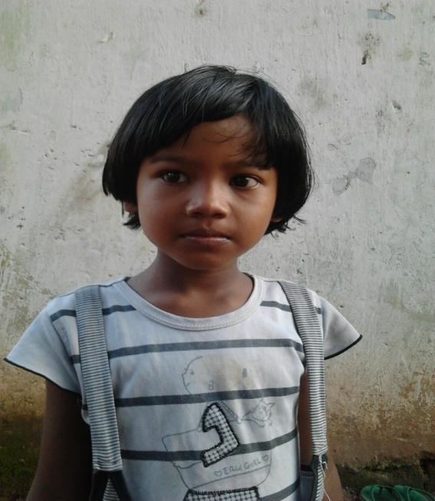
MOUSAMI PATRA
Class: III
School: SriKrishna Public School
Board of Education: ICSE
Monthly Income of Household: ₹3000
No. of members in family: 4
Total Annual Expenditure on Education: ₹18100
Sponsored by: MR. MANPREET SINGH ARORA

Slide 20
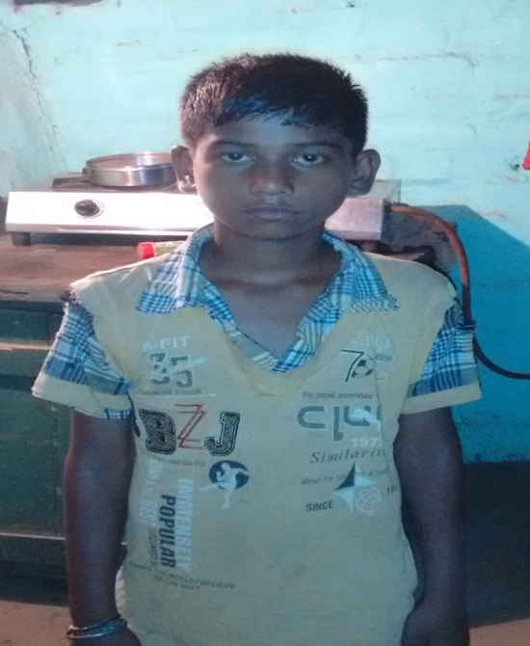
GOURAV KUMAR
Class: III
School: Victoria Public School
Board of Education: CBSE
Monthly Income of Household: ₹5000
No. of members in family: 5
Total Annual Expenditure on Education: ₹10650
Sponsored by: MR. MANOJ KUMAR PATEL

Slide 21
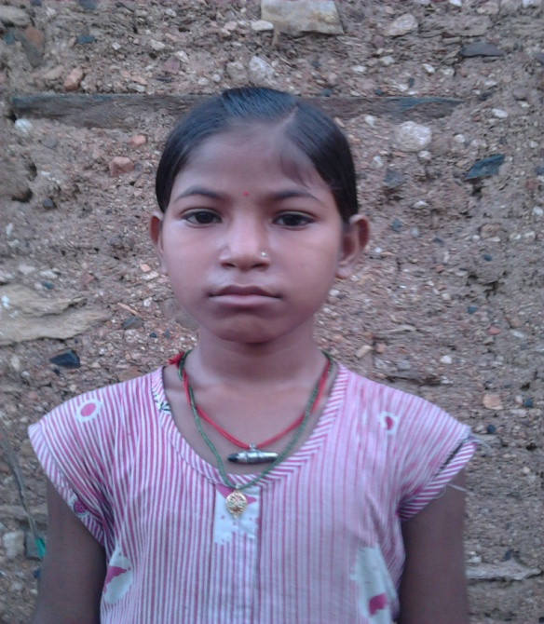
KAJAL KUMARI
Class: IV
School: Gayatri Shiksha Niketan
Board of Education: CBSE
Monthly Income of Household: ₹3500
No. of members in family: 5
Total Annual Expenditure on Education: ₹17050
Sponsored by: MR. PRAKASH SWARNAKAR

Slide 22
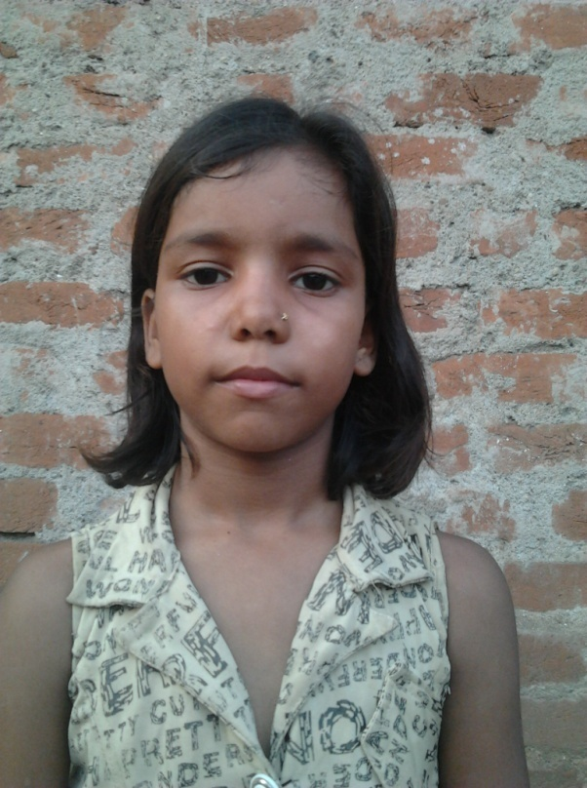
RIYA KUMARI
Class: IV
School: Gayatri Shiksha Niketan
Board of Education: CBSE
Monthly Income of Household: ₹3000
No. of members in family: 6
Total Annual Expenditure on Education: ₹16550
Sponsored by: MR. ABHISHEK PRAJAPATI

Slide 23
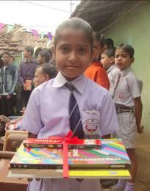
SIMRAN ADHIKARI
Class: VI
School: Central Public School
Board of Education: CBSE
Monthly Income of Household: ₹3500
No. of members in family: 5
Total Annual Expenditure on Education: ₹16850
Sponsored by: MR. VIVEK SHARMA

Slide 24
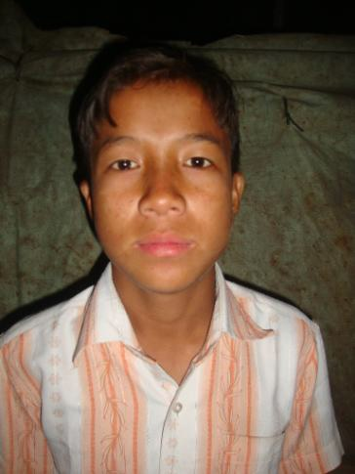
YAM KUMAR
Class: IX
School: Gayatri Shiksha Niketan
Board of Education: JAC
Monthly Income of Household: ₹3300
No. of members in family: 4
Total Annual Expenditure on Education: ₹16850
Sponsored by: MR. PANKAJ SONI

Slide 25
“You have not lived today until you have done something for someone who can never repay you.”
www.sankalpnitjamshedpur.org

