Slide 1


Slide 2
ANOTHER MILESTONE
A NEW BEGINNING

Slide 3
FIRST CORPORATE SPONSORSHIP BY TML DRIVELINES
On 1st July 2015, Sankalp-A Pledge to Change entered into a new phase of its realization towards the vision of a literate India when the President of Sankalp entered into an agreement with the CEO of TML drivelines for receiving monetary assistance and logistics support for establishing tuition centres and sponsoring complete education fee of underprivileged children in the tribal areas near Telco like Ghobandha and Birsanagar.

Slide 4
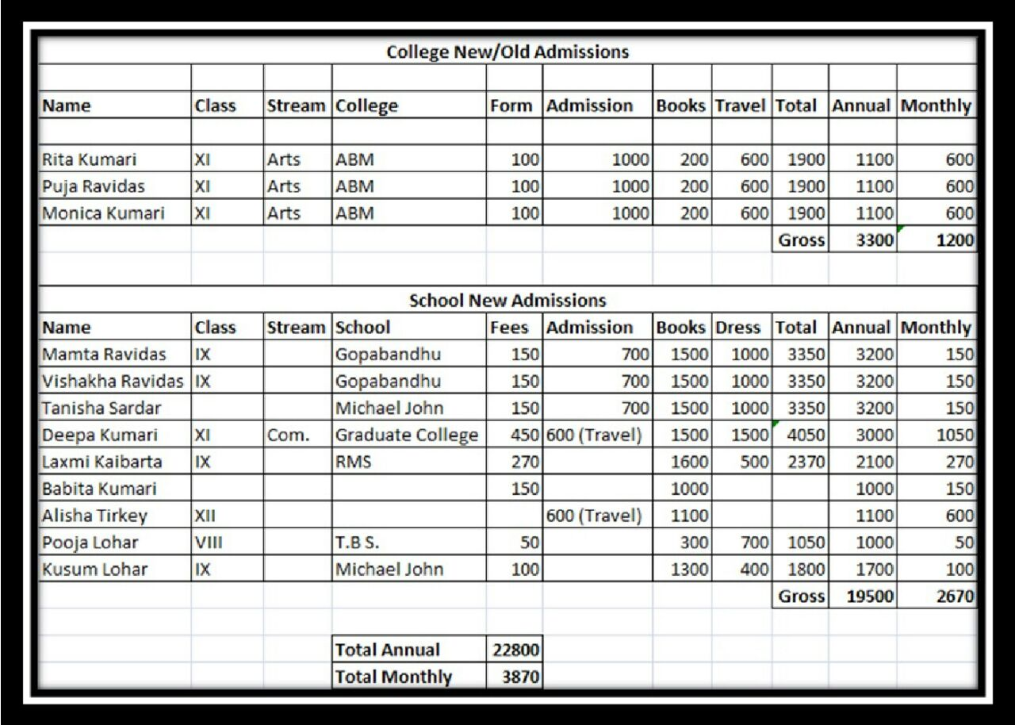
LIST OF BENEFICIARIES

Slide 5
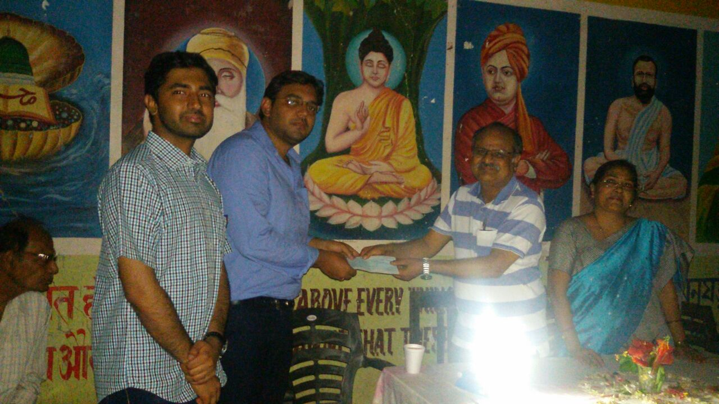
A HISTORIC MOMENT FOR SANKALP

Slide 6
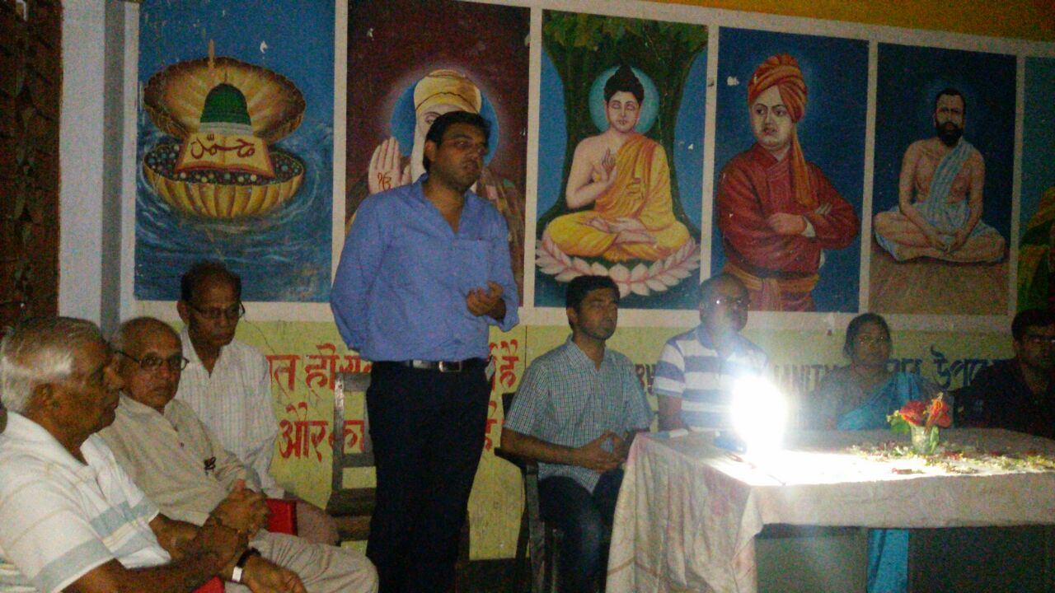
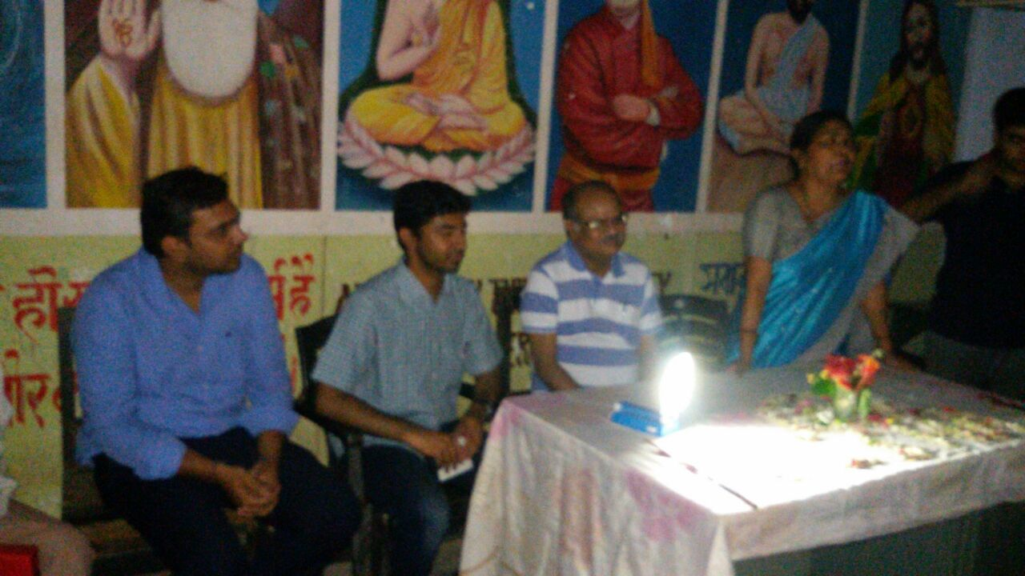
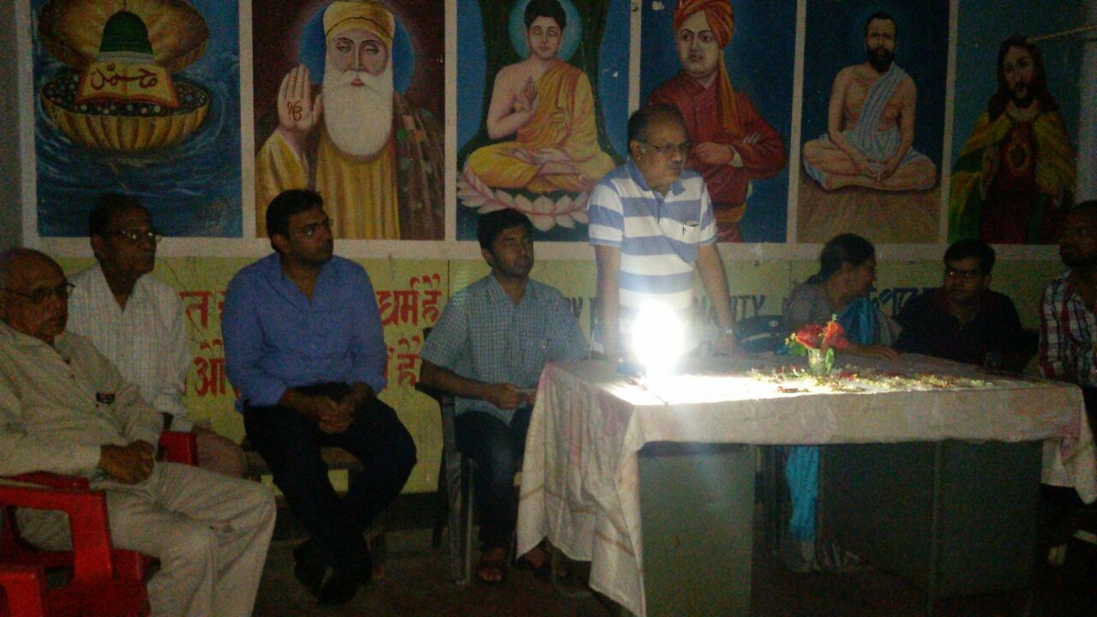
MOMENTS WITH CEO, TML DRIVELINES

Slide 7
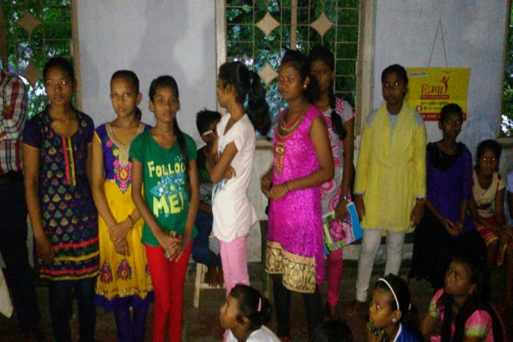
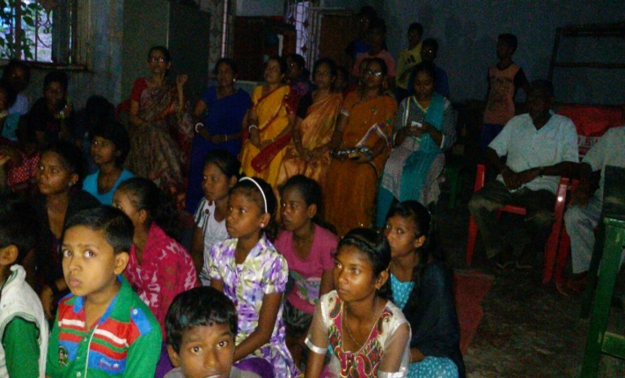
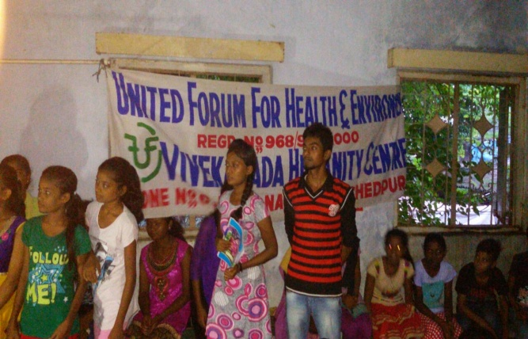
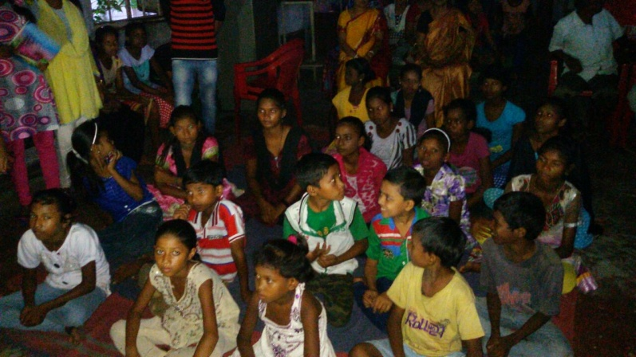
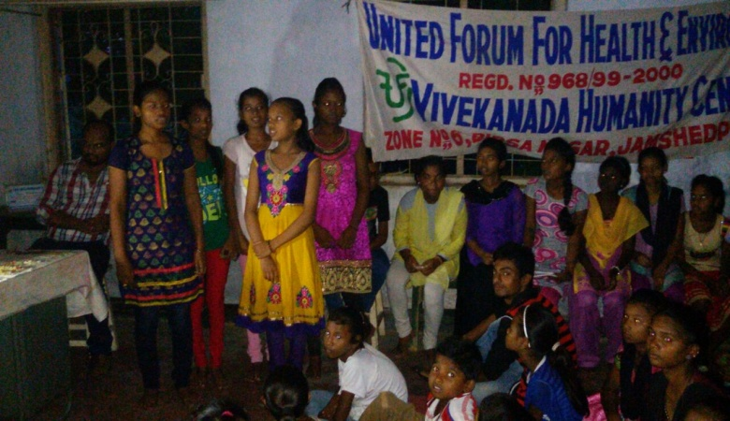
TUITION CENTRE AT BIRSANGAR
A JOINT INITIATIVE OF SANKALP AND UNITED FORUM NGO

Slide 8
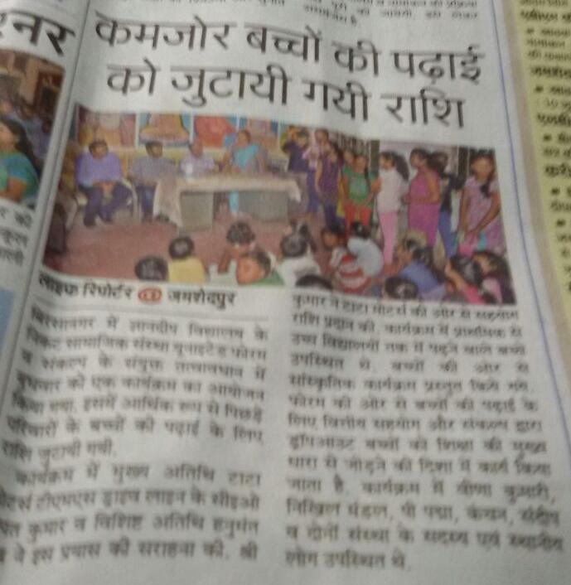
PRESS RELEASE

Slide 9
“You have not lived today until you have done something for someone who can never repay you.”
www.sankalpnitjamshedpur.org

